Slide 1
COMPUTER ARITHMETIC
Computer Organization and Assembly Language
Lec # 35 & 36
Computer Science Department
National University of Modern Languages
Islamabad

Slide 2
ARITHMETIC & LOGIC UNIT
Does the calculations
Everything else in the computer is there to service this unit
Handles integers
May handle floating point (real) numbers
May be separate FPU (maths co-processor)
May be on chip separate FPU (486DX +)
Notes:
Maths coprocessor is an optional processor that allowed a computer to perform mathematical calculations more efficiently and faster, increasing the overall speed of a computer in many places.

Slide 3
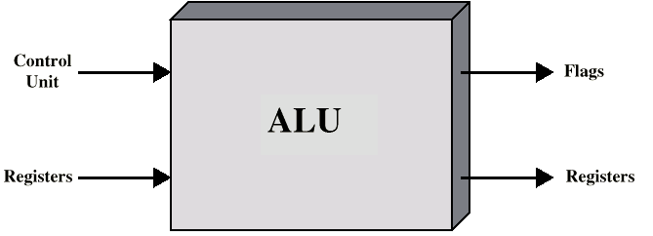
ALU INPUTS AND OUTPUTS

Slide 4
INTEGER REPRESENTATION
Only have 0 & 1 to represent everything
Positive numbers stored in binary
  e.g. 41=00101001
No minus sign
No period
Sign-Magnitude
Two’s compliment

Slide 5
ADDITION AND SUBTRACTION
Normal binary addition
Monitor sign bit for overflow
Take twos compliment of the operand to be subtracted and add to minuend
  i.e. a - b = a + (-b)
So we only need addition and complement circuits

Slide 6
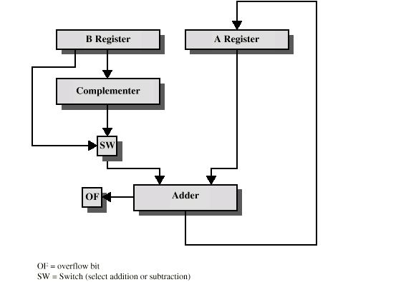
HARDWARE FOR ADDITION AND SUBTRACTION

Slide 7
MULTIPLICATION
Complex
Work out partial product for each digit
Take care with place value (column)
Add partial products

Slide 8
MULTIPLICATION EXAMPLE
1011 Multiplicand (11 dec)
x 1101 Multiplier (13 dec)
1011 Partial products
0000x Note: if multiplier bit is 1 copy
1011xx multiplicand (place value)
1011xxx otherwise zero
10001111 Product (143 dec)
Note: need double length result

Slide 9
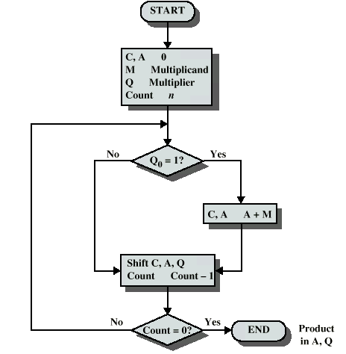
FLOWCHART FOR UNSIGNED BINARY MULTIPLICATION

Slide 10
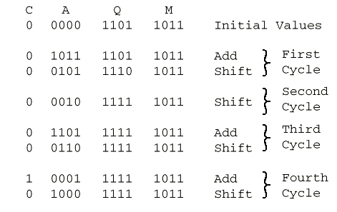
EXECUTION OF EXAMPLE
Notes:
If q₀ =0 then only shift.
Else first Add M into A and then perform shift right on A and Q using C bit.

Slide 11
MULTIPLYING NEGATIVE NUMBERS
This does not work!
Solution 1
  Convert to positive if required
  Multiply as above
  If signs were different, negate answer
Solution 2
  Booth’s algorithm

Slide 12
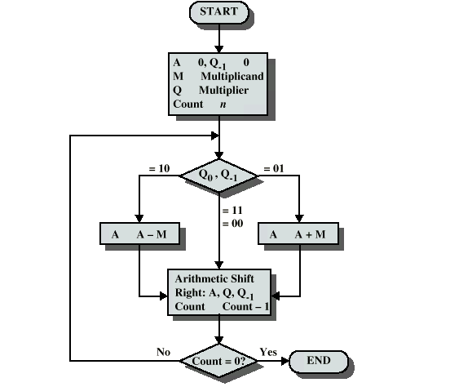
BOOTH’S ALGORITHM

Slide 13
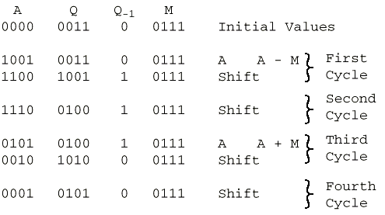
EXAMPLE OF BOOTH’S ALGORITHM

Slide 14
DIVISION
More complex than multiplication
Negative numbers are really bad!
Based on long division

Slide 15
DIVISION OF UNSIGNED BINARY INTEGERS
00001101
Quotient
Divisor
1011
10010011
Dividend
1011
001110
Partial
Remainders
1011
001111
1011
Remainder
100

Slide 16
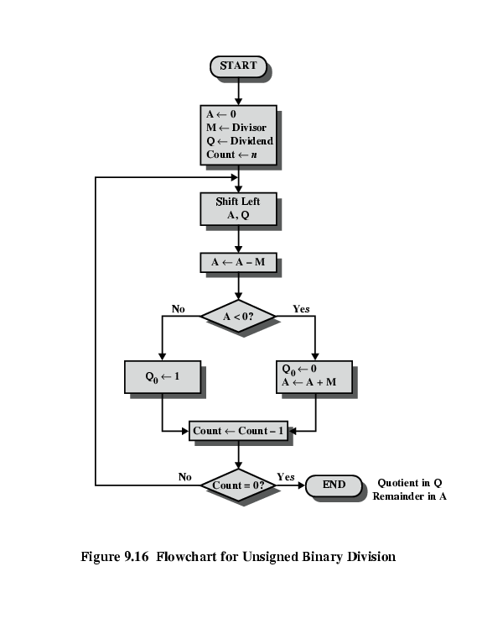
FLOWCHART FOR UNSIGNED BINARY DIVISION

Slide 17
REQUIRED READING
Stallings Chapter 9
IEEE 754 on IEEE Web site

